Slide 1
HIGHER EDUCATION
A Virtual Reality Theater Experience

Slide 2
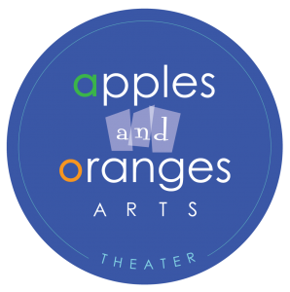
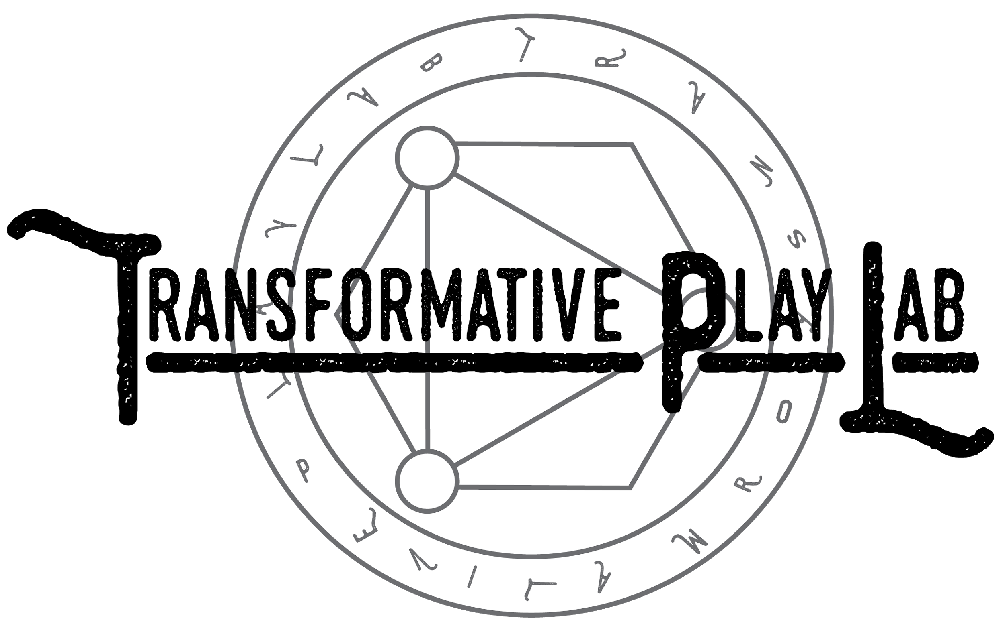

The Team
Notes:
We are an interdisciplinary team of artists, and programmers, both undergrad and graduate students of UC Irvine, and we had the opportunity to work with Prof Josh Tannenbaum from Transformative Play Lab who led the AR/VR Theatre course and Tim Kashani and Zach Anderson from Apples and Oranges Arts Theatre Productions to explore and create a new Virtual reality theatre experience.

Slide 3
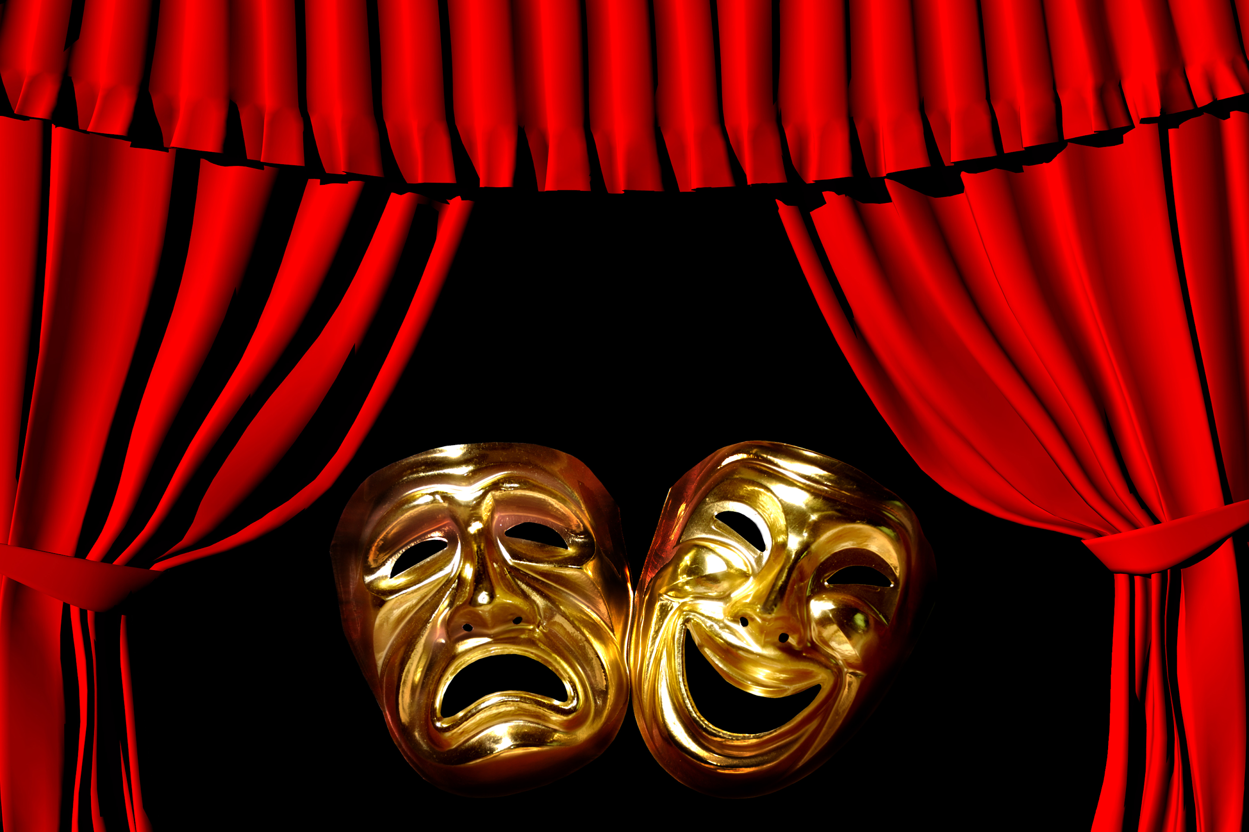
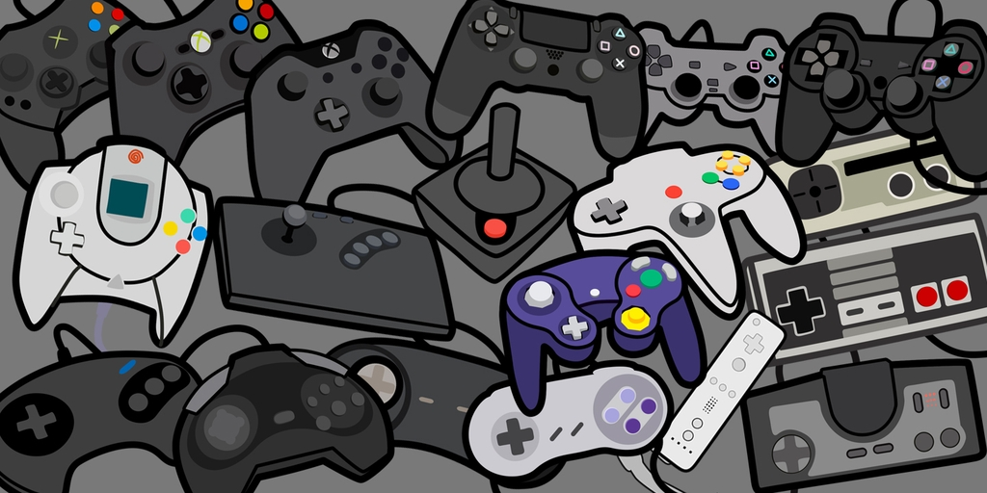

What’s different?
Every user perceives the experience differently based on their interactions
Notes:
Audiences are familiar with theatre which is in the moment and spontaneous. Players are familiar with games where they may choose and interact in a dynamic environment. Our work sits between these two mediums. We seek to create interfaces for audiences to emotionally engage in dynamic theater experiences.

Slide 4
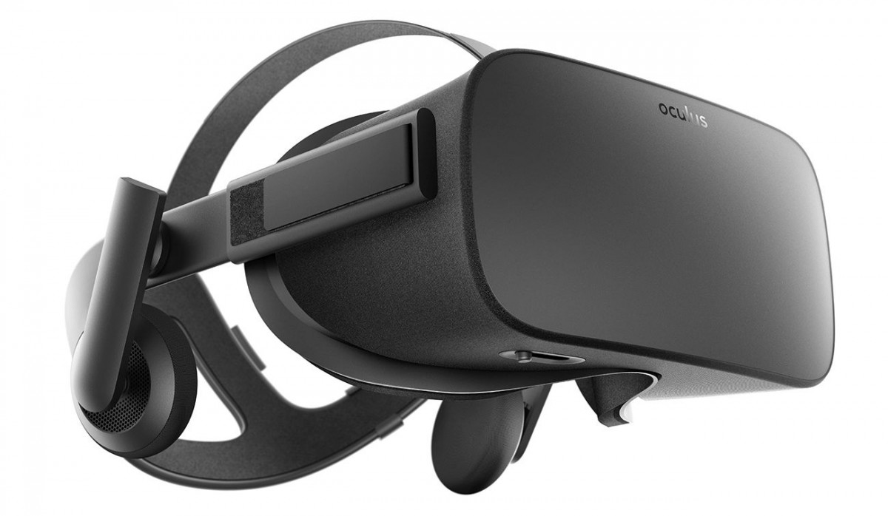


Technology
Notes:
To develop this unique interaction model, we chose the Oculus Rift as our VR device which also integrates well with Unity for development

Slide 5

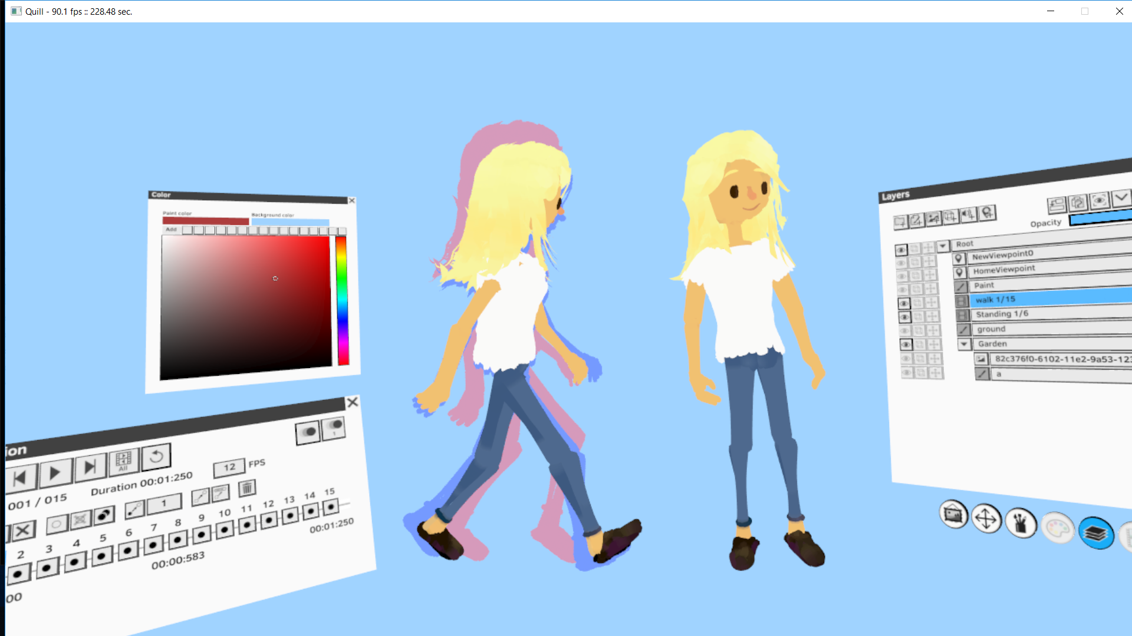
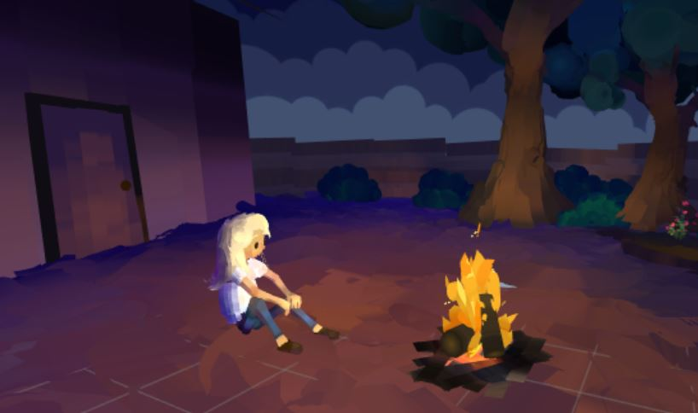
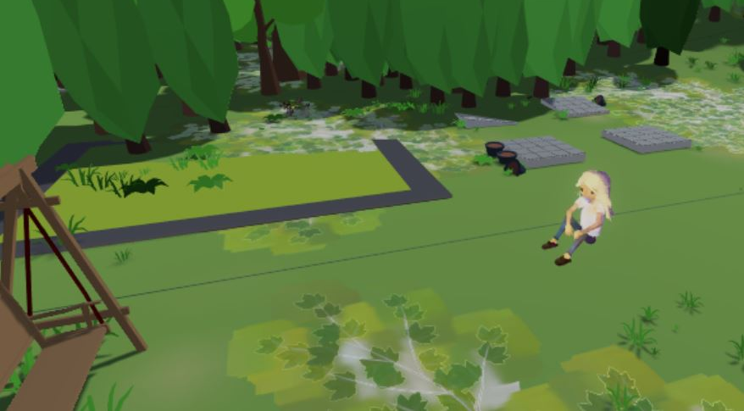
Animation - Quill VR & Unity VR
Notes:
As we worked in VR, it was exciting getting to see the potential that it has as an artistic tool. We discovered Quill, an oculus app that gives you the ability to paint and animate in a VR space. Rather than using a traditional 3D animation pipeline, we were able to actually create and animate our assets inside this virtual space and then easily export and integrate them into Unity.

Slide 6
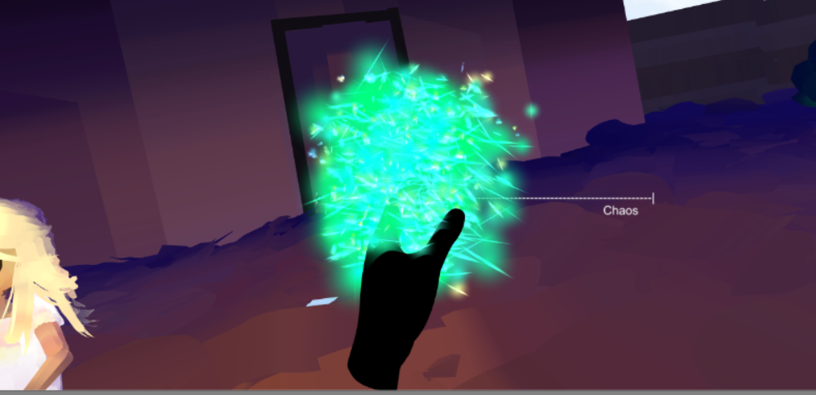
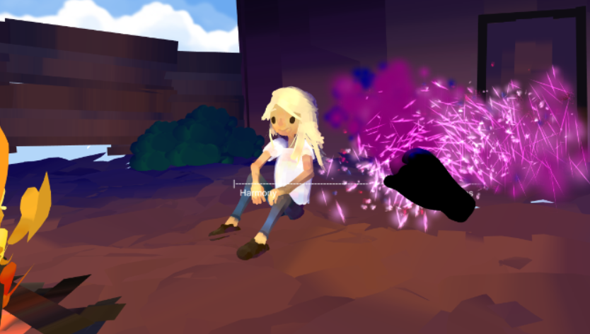

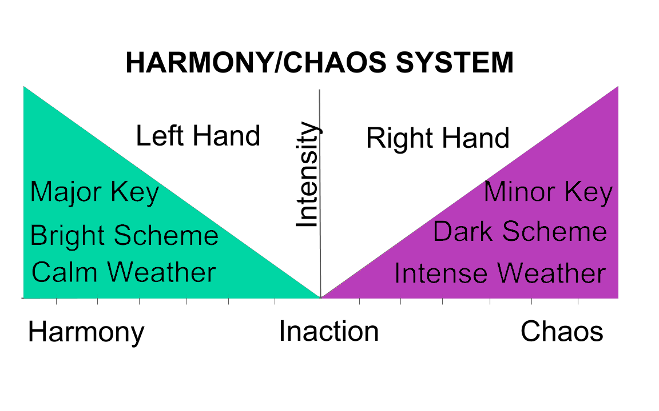
Interaction
Model
Notes:
As Higher Education is a musical, we wanted to give the players the feeling of being a type of conductor. With the left hand, the player creates a more harmonious mood while with the right hand, the player creates a more chaotic mood. Harmony is accompanied by music in major key, a brighter color scheme, and calmer weather while chaos is accompanied by music in minor key, a darker color scheme, and more intense weather. The player can move between and within these states in a dynamic and continuous experience.

Slide 7


Design process - Narrative
Notes:
Ultimately, all the technology discussed before is would not be a very engaging experience without good characters and story. We were very lucky to have Tim Kashani who is also a writer of the musical Higher Education help us with that, and in todays demo, users will get a sneak peak into the life of the plays main protagonist Amanda and the world of guardian angels.
That being said, the interaction mechanism is definitely not specific to this story. Music and lighting are so powerful at communicating emotions, and being able to interact with them within a narrative could be creatively extended to any setting for any story, and that’s what makes this project all the more exciting.

Slide 8
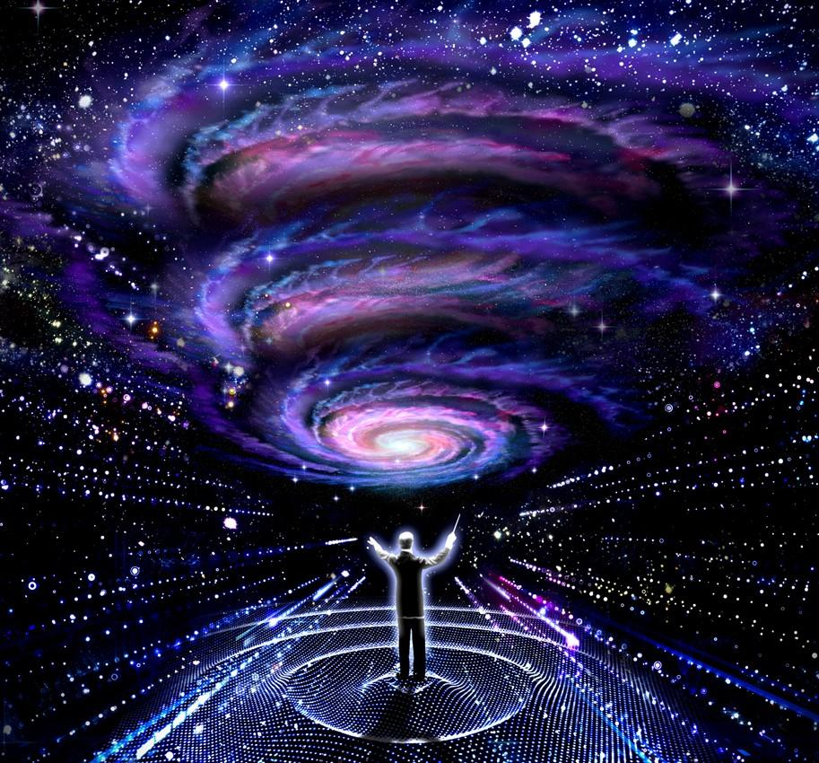
Notes:
On that note, I would like to invite everyone to step inside the role of a guardian angel and become a musical conductor in our Virtual Reality Experience, Higher Education.

Slide 9
Thank You
Notes:
Thank you

